Slide 1
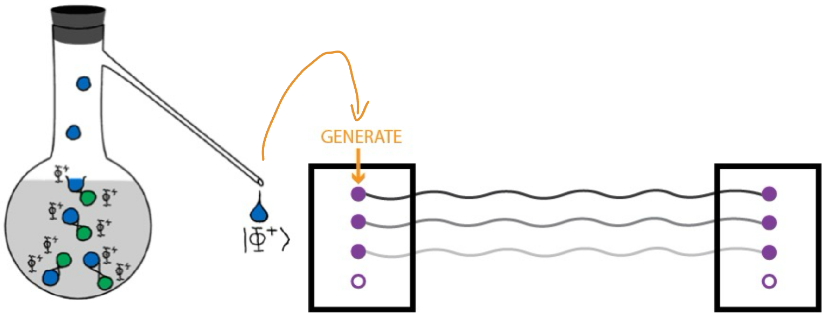
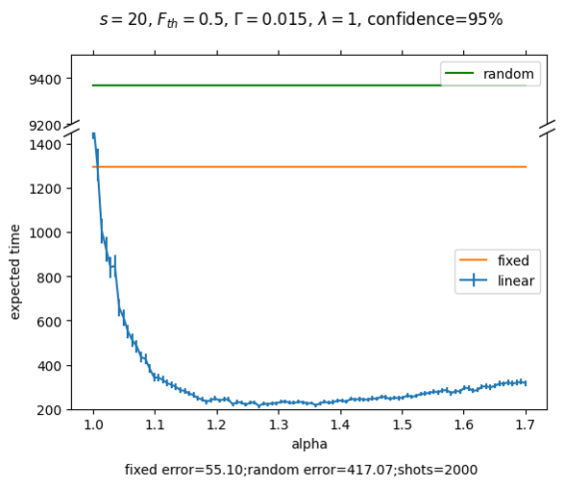
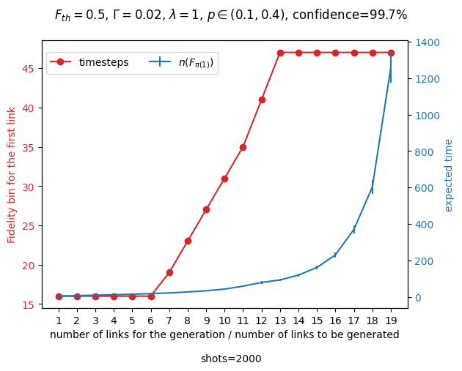
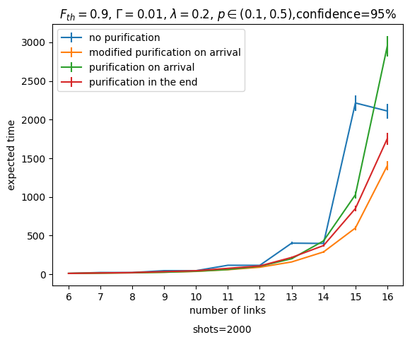
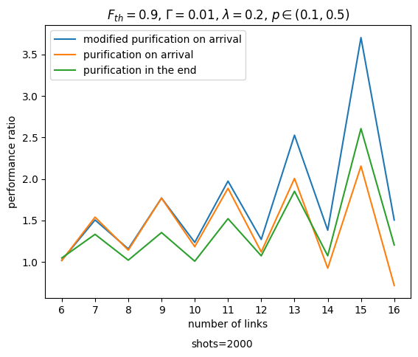




1 Additional Background
A Heuristic approach for resource generation in a quantum network with purifications
By Tianchen Qu | Email: T.QU@student.tudelft.nl
Supervisor: Bethany Davies
Responsible professor: Gayane Vardoyan
Add your information, graphs and images to this section.
1 Research Question
3 Entanglement Purification
4 Methodology
6 Summary and future goals
How can we find a policy to minimize the average time for generating multiple links?
Entanglement purification can bring low-fidelity entangled links to higher fidelity with some success probability.
Two schemes are used here: EPL-D and DEJMPS [1].
Input: two identical states with fidelity $F$
Output: one new link with some probability
EPL-D creates a perfect entangled link with probability $\frac{F^{2}}{2}$
DEJMPS creates a link with fidelity $\frac{10F^{2}−2F+2}{8F^{2}−4F+5}$ with probability $\frac{8F^{2}−4F+5}{9}$
We can find an optimal action for all actions with the same fidelity bin ${\left(p_{N},F_{N}\right)}_{optimal}=argmax\left\{p_{a}:a∈𝒜,n\left(F_{a}\right)=N\right\}$ and the continuous action space is reduced:
$$𝒜^{∗}=\left\{{\left(p_{N},F_{N}\right)}_{optimal}:N∈Bin\right\}.$$
Heuristic
We generate links with fidelity bin proportional to the estimated time to generate future links.
$$n\left(F_{current}\right)=α⋅t_{ahead}$$
A policy can be derived using dynamic programming with a tunable factor $α$.
Purification
With purification, we assume each action will produce two identical link copies upon success
First approach: Purify on arrival using EPL-D scheme. We model the purification as part of the action
Second approach: Purify in the end, where we automatically purify links that about to expire
The heuristic performs well particularly for generating large number of links.
Generating too many links will reduce the heuristic to fixed actions.
Entanglement purification can speed up generation.
Non-linear trade-off functions can be explored for more realistic simulations.
A non-static policy where $t_{ahead}$ is estimated based on the current state can improve the performance.
More purification schemes can be explored.
2 Problem Setting
Markov Decision Process
The links suffer from depolarizing noise for each timestep.
Links with a lower fidelity than the threshold $F_{th}$ are discarded.
Fidelity bin is the discrete lifespan of an existing link.
State Space
The current state is the set of fidelity bins for each link in the register.
Action Space
Each entanglement generation attempt is an action $(p_{a},F_{a})$ with probability $p_{a}$ to generate a link with fidelity $F_{a}$.
Heralded entanglement generation offers a continuous action space:
$$𝒜=\left\{\left(p_{a},F_{a}\right)∈{\left(0,1\right)}^{2}:F_{a}=1−λp_{a}\right\}.$$
References
[1] F. Rozpędek, T. Schiet, L. P. Thinh, D. Elkouss, A. C. Doherty, and S. Wehner, ‘Optimizing practical entanglement distillation’, Phys. Rev. A, Jun. 2018
[2] ChunYang Ding. Distillation method strengthens quantum entanglement in a single pair of photons. Physics world, 2021
[3] Adapted from B. Davies with permission
Figure adapted from [2][3]
5 Results

Slide 2
5 Results

Slide 3
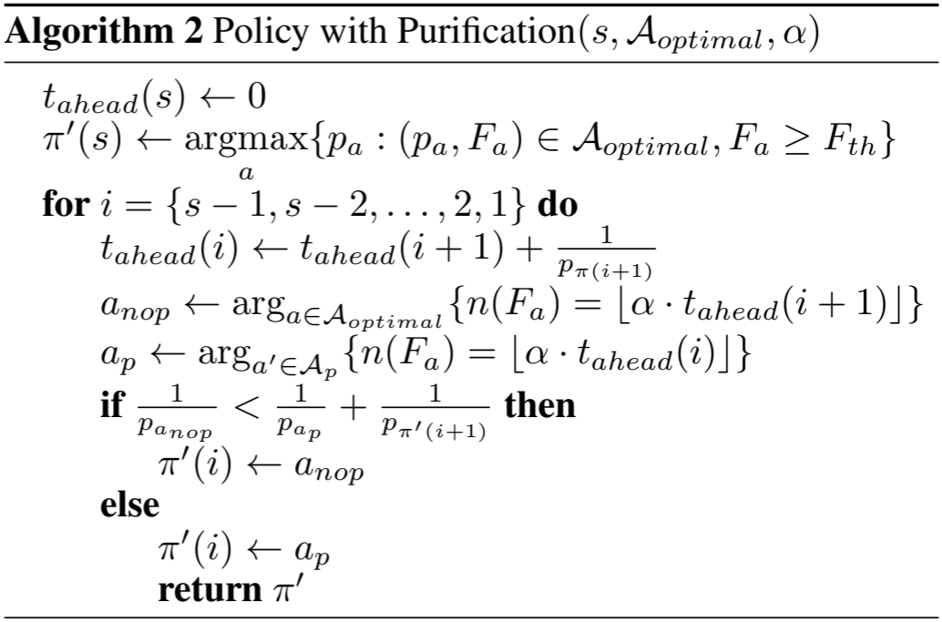
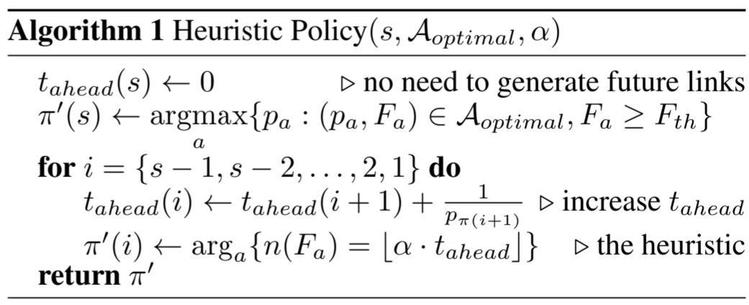
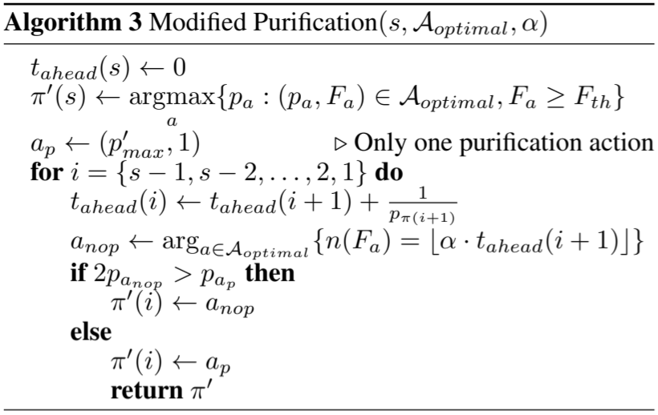
Algorithm for generating the policy

Slide 4
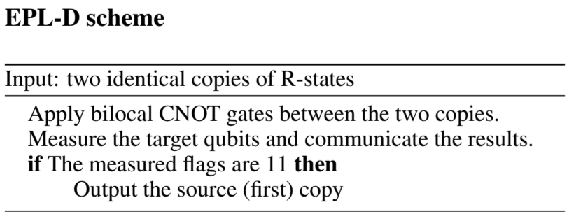
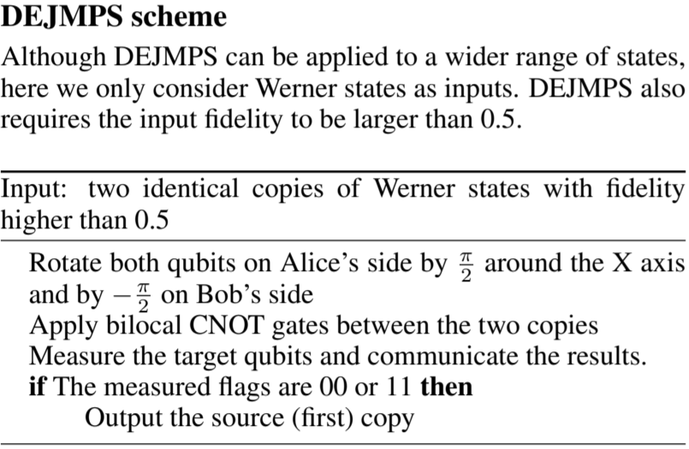
Entanglement Purification Schemes
R-states: $ρ=F|Ψ^{+}⟩⟨Ψ^{+}|+\left(1−F\right)|00⟩⟨00|$
Werner states: $ρ=\frac{4F−1}{3}|Ψ^{+}⟩⟨Ψ^{+}|+\frac{\left(1−F\right)}{3}I$

